Slide 1
Applicant’s Conference 2018-19 Request for Proposal
One (1) Enhanced Behavioral Support Home

Slide 2
Overview of Project – Enhanced Behavior Support Home (EBSH) - for Adults
Start up funds will be dependent on final approval from DDS for this project.
One (1) EBSH for two adults.
Max licensed capacity is for (2) residents, with individual bedrooms for each resident.
Home shall be 24 hour non-medical with enhanced behavior support staff and services.
Understanding of ABA principles, experience implementing treatment plans, RBT certification, previous experience working with individuals with developmental disabilities.

Slide 3
Overview- continued
i.e. BCBA consultant, licensed psychiatrist, licensed professional clinical counselor(LPCC), mental health specialist, forensic specialist, etc.
Residents may be dual diagnosed (mental health and DD) and there may be forensic concerns/criminal involvement. Residents will need:
Anger/aggression management;
Substance abuse prevention and treatment;
Mental health services;
Medication management;
Health care services;
Comprehensive services.

Slide 4
Overview of Project – SRF for Adults, continued
Facilities must meet the new regulations issued by CMS to continue to receive funding beyond March 2022.
This includes a high degree of community integration.
Facilities must be located within SG/PRC catchment area.

Slide 5
Types of Individuals to be Served
Adults (18-59) ; male(s) or female(s)
Individuals to be served currently reside in either IMD’s, state operated facilities, locked facilities or psychiatric facilities.
Individuals will present significant behavioral challenges including:
Self-Injurious behaviors
Physical and verbal aggression
Elopement
Transition Difficulties
Disruptive social behavior
Forensically involved
Property destruction
PICA, etc.

Slide 6
Individuals to be Served Continued
The selected provider must adopt a “no reject” policy toward individuals, with a commitment to modifying supports as needed to accommodate specific needs.
Provider must communicate a vision dedicated to long-term, stable support in inclusive communities.

Slide 7
Client to be Served
37 year old female;
Mild ID, Schizophrenia, Schizoaffective Disorder-BiPolar type;
Previous placements have been at IMDs, specialized residential facilities including homes with delayed egress and secured perimeters, psychiatric hospitals and currently residing at College Hospital;
Current targeted behaviors: Physical Aggression, Inappropriate boundaries, Vocal disruption;
Has difficulty regulating her emotions and struggles to use her coping skills when upset;

Slide 8
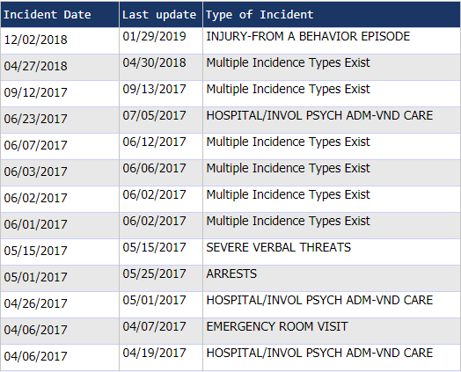
Primary Individual to be Served – Partial SIR History

Slide 9
Staffing
Administrator must be one of the following:
A Registered behavior technician(RBT);
A Licensed Psychiatric Technician (RBT);
A Qualified Behavior Modification Professional.
EBSH regulations require a lead staff on each shift (168 per week);
This cost is part of the ‘facility rate’;
The lead staff person must either be an Licensed Psychiatric Technician (LPT) or a Registered Behavior Technician (RBT) within established timeline
Recruitment and development of staff on an on-going basis is essential

Slide 10
Rate Negotiation
EBSH for Adults
Rate for the EBSH includes a fixed facility component for residential services and an individualized service and supports rate component based on each client’s needs as determined through the IPP process.
The home will be owned by a Non-Profit Housing Organization (NPO) that will own and renovate the property; the awarded CPP recipient will lease the home from the NPO.

Slide 11
Equity and Diversity
Your proposal should address a commitment to:
Serve diverse populations, including, but not limited to, culturally and linguistically diverse populations
Address the needs of these diverse populations
Include additional information that the applicant deems relevant to issues of equity and diversity

Slide 12
Timeline
Posting of RFP 5/28/19
Deadline for submission 6/4/19 (4 pm)
Evaluation of proposals 6/5/19-6/7/19
Award Notification 6/10/19
Start-Up Contract Signed 6/12/19
Notification posted (on SG/PRC website) 6/28/19

Slide 13
RFP Specifics
Benilda Glen, Resource Developer (bglen@sgprc.org or (909) 868-7512) will be the lead RD for this project. Questions can also be directed to resources@sgprc.org.
Proposal due by 6/4/19 at 4 p.m. (no exceptions)
Ensure that you follow all instructions and include all information in sections 1 – 16 &
follow formatting requirements.

Slide 14
RFP Process
RFP – Request for Proposal
Cover Sheet – Attachment A
Other Attachments
Attachment B – Statement of Obligation
Attachment C – Comparable Projects Listing
Attachment D – Sample Financial Statement / Independent Audit
Attachment E – Projected Start-up Costs Worksheet
Attachment F – Rate Development Facility Costs
Attachment G – DS1891 Applicant Disclosure Statement

Slide 15
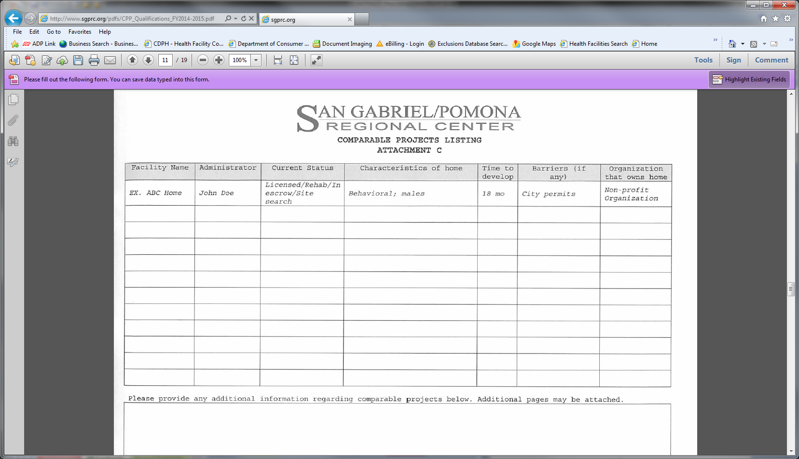
RFP Process, continued
Attachment C – Comparable Projects Listing

Slide 16
RFP Process, continued
Important information to be descriptive about:
Expertise: potential provider must have experience supporting individuals with significant challenging behaviors, mental health, forensic backgrounds .
Applicants must adopt a “no-reject”/no failure policy toward individuals and a commitment to modifying supports to ensure continued stability without the need to request additional funds from SG/PRC.

Slide 17
RFP Process, continued
Important information to be descriptive about:
Description of Client/Agency Outcomes: what are anticipated outcomes and how will they be measured.
Methods and Procedures: How will vendor provide for the needs of the clients in areas such as, but not limited to, supervision, behavioral support, health needs, mental health needs, education, vocational training, social skills and community integration
This EBSH must be developed to meet the new regulations issued by Centers for Medicare and Medicaid Services [http://www.dds.ca.gov/HCBS/docs/HCBSRegsOverview.pdf] – i.e. each client must have private bedroom

Slide 18
Thank you for attending!
Any questions?

