Slide 1
SG/PRC POS Expenditure Data – FY19-20
Putting the Pieces Together –
Comparing FY14-15 with FY19-20 Data
Comparing Top Ten Take-Aways from FY18-19 with FY19-20
Equity Grant Projects to Increase Access to Services
February – March 2021 Presentations

Slide 2
Before we get started --
Please use the chat function:
To sign in – state if parent/family member, vendor, RC staff, Community Member (state affiliation)
To submit questions
To provide suggestions

Slide 3
Presenting information differently this year
Using a different format from previous years.
Skipping the demographic information and much of the basic information that has remained essentially the same over the past several years.
Notes:
For those interested in the basic demographic data, please refer to the power point presentation from FY18-19 posted to our website.

Slide 4
Historical Demographics
Available on SG/PRC website – www.sgprc.org
Follow the links to Governance => Transparency & Access to Public Information => Annual Purchase of Services (POS) Expenditure Reports => Purchase of Service Expenditure Reports by Fiscal Year => then select the fiscal year you wish to review to see data reports, SG/PRC power point presentations, SG/PRC reports to DDS.
Notes:
For those interested in the basic demographic data, please refer to the power point presentation from FY18-19 posted to our website.

Slide 5
Things to keep in mind
Remember SG/PRC presents information that provides –
Focus on individuals living with their families
Recognition of important differences between age groups (e.g., available generic resources)
Focus on major ethnic/racial groups
Focus on most prevalent languages in SG/PRC area

Slide 6
Information presented differently this year
Focus on change over last five years from FY14-15 to FY19-20, from before equity projects were initiated through June 2020.
Focus on the “Top Ten Take-Aways” from last presentation (FY18-19) compared with FY19-20 data.

Slide 7
What has been accomplished over the past five years?
Comparing the Purchase of Services (POS) Expenditures by Ethnic Group and Age from FY 14-15 and FY 19-20
Notes:
Important to note that not straight-line change. Can have lots of variability between each of the years. But gives a general sense of trend.

Slide 8
What has been accomplished since FY14-15? Keep in mind --
POS Expenditure Data is just one piece of the “puzzle” to understanding differences between ethnic/language groups.
What are the other pieces?
Cultural/individual preferences
Identification of needs and offering services
Availability of appropriate services
Satisfaction with services and supports
Generic resources not included in expenditure data
Personal choice to use/not use regional center services offered
---- AND IMPACT of COVID

Slide 9
What has been accomplished over the past five years?
How has COVID-19 affected the outcome of FY19-20 expenditures?
About 4 months of FY19-20 affected (1/3 of year).
Overall utilization for those living at home dropped from 74.6% to 70.6% from FY14-15 vs FY19-20. (Overall utilization in FY18-19 was 73.6%)
Notes:
The affect of COVID definitely an important piece of the puzzle. Next year will be even more dramatic in terms of COVID impact.

Slide 10
Individuals Living At Home – Ages 0 – 2 Comparing FY14-15 to FY19-20
Filipino was the group with lowest expenditures in FY15 at $3022. That group is no longer reported separately, so their numbers have been included in the Asian group, consistent with the U.S. census ethnic groupings.
African-American had the next lowest expenditures in FY15 at $3683. That group continued to have the lowest expenditures in FY20 at $5181.
“White” group had second lowest expenditures in FY15 at $3724.
Notes:
Largest disparity seen in African American Group for ages 0-2. All dollar figures are annual per capita (average) amounts.

Slide 11
Comparison of FY15 & FY20 Expenditures by Ethnicity Age 0-2
FY20 Average
FY15 Average
Notes:
Focus on lowest expenditures this time for this slide. Also point out the number below average in FY15
Asian FY15: changed to include Filipino ($1,156,019+ Explain what “Other” means. Number of “Other” individuals greater (1389) than then number of “white” individuals (1,281) or Black/African-American individuals (492) served overall. For 0-2 group, “Other” group is also larger (479) than for Asian 0-2 individuals (378).
Other = Total – (Asian+Black+Hispanic+White)

Slide 12
Individuals Living At Home – Ages 0 – 2 Comparing FY14-15 to FY19-20 – cont’d
Group with highest expenditures in FY15 was “Other” at $4911. Hispanic group had second highest expenditures at $4597.
Group with highest expenditures in FY20 was Asian at $6723. White group a close second at $6722.
Average increase in expenditures over five years was 39.1%. Largest increase over the five years was for the White group, at 80.5%.
Notes:
Be sure that you talk about what is meant by “Other” here if not before. “Other” was a larger group than African-American and similar (but smaller) than Asian in FY15

Slide 13
Comparison of FY15 & FY20 Expenditures by Ethnicity Age 0-2
FY20 Average
FY15 Average
Notes:
Focus on the highest expenditures this time. Also look at the % change from 15 to 20.
Asian FY15: changed to include Filipino ($1,156,019+
Other = Total – (Asian+Black+Hispanic+White)

Slide 14
Individuals Living At Home – Ages 3 – 21 Comparing FY14-15 to FY19-20
In FY 15, African-American expenditures the lowest at $4260.
Next lowest in FY15 was Hispanic expenditures at $4310.
In FY20, Hispanic expenditures remained low and became the lowest at $5242, with 21.6% increase over five years.
See bar graph
Notes:
Largest disparity for this age group was in Hispanic group.

Slide 15
Comparison of FY15 & FY20 Expenditures by Ethnicity Age 3-21
Notes:
This is why we look at age break downs. The lowest group in FY15 became the highest in FY20.
Asian FY15 – changed to include Filipino
Other = Total – (Asian+Black+Hispanic+White)

Slide 16
Individuals Living At Home – Ages 3 – 21 Comparing FY14-15 to FY19-20, cont’d.
In FY15, the highest expenditures were for Asian group.
In FY20, African-American expenditures the highest for all major ethnic groups at $7,482 – an increase of 76%.
Next highest group in FY20 was “Other” at $6489, which was only an increase of 13.9%.
Average increase was 20.2% over five years.
See bar graph
Notes:
“Other” group is larger than “white” or African American and more comparable to Asian in numbers in 2020.

Slide 17
Comparison of FY15 & FY20 Expenditures by Ethnicity Age 3-21
Notes:
Focus on % of change for African-American group
Asian FY15 – changed to include Filipino
Other = Total – (Asian+Black+Hispanic+White)

Slide 18
Individuals Living At Home – Ages 22+ Comparing FY14-15 to FY19-20
In FY15, lowest expenditures seen in Hispanic group at $7177.
Hispanic group only group below average in FY15. (“Average” calculation also includes American Indian, Alaskan Native, Native Hawaiian, other Pacific Islander – small numbers.)
In FY20, African American adults had lowest expenditures at $10,614, with Hispanic adults at next lowest expenditures at $11,010.
Notes:
Continue concern about low use of POS services for both Hispanic and African-American.

Slide 19
Comparison of FY15 & FY20 Expenditures by Ethnicity Age 22+
FY20 Average
FY15 Average
Notes:
Focus on lowest expenditures
Asian FY15 – changed to include Filipino
Other = Total – (Asian+Black+Hispanic+White)

Slide 20
Individuals Living At Home – Ages 22+ Comparing FY14-15 to FY19-20, cont’d.
FY15 highest expenditures for “Other” group, at $9,149.
“Other” continued to be the group with the highest expenditures in FY20, with 41.4% increase.
Comparing FY15 and FY20, Hispanic group had 53.5% increase while African American only had a 31.3% increase.
Average increase was 50.1%
Notes:
Increase in Other not as large for the adult group vs the 0-2 and 3-21 groups.

Slide 21
Comparison of FY15 & FY20 Expenditures by Ethnicity Age 22+
FY20 Average
FY15 Average
Notes:
Focus on Highest expenditures.
Asian FY15 – changed to include Filipino
Other = Total – (Asian+Black+Hispanic+White)

Slide 22
What did these results tell us?

Slide 23
Comparing the Top Ten Take-Aways
FY18-19 vs. FY19-20
Notes:
Now switching to our second main topic – comparing last report to the current report, looking at top ten takeaways.

Slide 24
FY18-19 $919,035 awarded FY16-17; total of $1,784,241 for 15 equity projects through FY19-20.
FY19-20 Requesting four (4) continuation grants for FY20-21:
PMI, NRCS, Asian Outreach Specialist, Webinar Development - $418,930. Results not yet known.
#1
Notes:
Important to note that not straight-line change. Can have lots of variability between each of the years. But gives a general sense of trend.

Slide 25
FY18-19 Three significant projects creating positive change: PMI, NRCS, Pers0n-Centered Thinking
FY19-20 Parent Mentor Initiative (PMI) – 294 referred; 224 matched; 198 served.
Navigating Regional Center Services (NRCS) – 400 registered; 279 participated; total 12 workshop series (5 Spanish, 7 English).
Continuing Person-Centered Thinking (PCT) approach in all our business practices.
#2
Notes:
Important to note that not straight-line change. Can have lots of variability between each of the years. But gives a general sense of trend.

Slide 26
FY18-19 Positive change noted for Hispanic families; especially Spanish-speaking families with no POS invited to participate in PMI, NRCS
FY19-20 PMI – 294 referred; 224 matched; 198 served.
NRCS – 400 registered; 279 participated; total 12 workshop series (5 Spanish, 7 English).
Continuing Person-Centered Thinking in IPPs
#3
Notes:
Important to note that not straight-line change. Can have lots of variability between each of the years. But gives a general sense of trend.

Slide 27
FY18-19 Age and living arrangement powerful determiners of authorizations, expenditures, utilization. Over 80% of individuals served live at home with family.
FY 19-20 Actual numbers have increased; percentage is 80.8%. Remains similar.
Average per capita authorizations = $10,602 and average expenditures = $7,481, regardless of ethnicity or age.
Hispanic lowest group overall, with lowest expenditures in 3-21 and 22+ age groups –but not for Early Start.
#4
Notes:
Important to note that not straight-line change. Can have lots of variability between each of the years. But gives a general sense of trend.

Slide 28
General Facts - By Residence FY17-FY20
Notes:
State DC = Developmental Center/State Hospital
Health Facilities = ICF Facility & Continuous Nursing + Psychiatric Treatment Facility + Sub-Acute

Slide 29
FY18-19 Overall SG/PRC expends more POS each year than the previous year across all ethnic groups.
FY19-20 -- 11.7% increase in overall expenditures for 15,393 served and 8.99% increase in expenditures for those living with family over the previous year. Increase from $87,926,464 to $95,829,982 for those living at home.
#5
Notes:
See graph next slide.

Slide 30
Comparison of POS Expenditures by Living Option FY19-FY20

Slide 31
FY18-19 Hispanic babies and toddlers had authorizations and expenditures higher than all other major ethnic groups. Also had lowest NO POS compared to all other ethnic groups.
FY19-20 Hispanic babies remained above average in authorizations and expenditures compared to the average; but no longer the highest in authorizations and expenditures.
NO POS was at 1.1%. (21 of 1833 with no POS)
Hispanic only group above average last 3 years.
#6
Notes:
Important to note that not straight-line change. Can have lots of variability between each of the years. But gives a general sense of trend.

Slide 32
Comparison of Per Person Authorizations & Expenditures Data
FY 18 to FY 20 Age 0-2 Living at Home by Ethnicity
FY 18 | FY 19 | FY 20

Slide 33
No POS % by Age – Hispanic Spanish vs. English Language --FY20
Notes:
English Hispanic = Hispanic – Spanish

Slide 34
FY18-19 Hispanic school-aged children and adults had the lowest authorizations and expenditures compared to other major ethnic groups. But utilization % was higher than other ethnic groups.
FY19-20 Hispanic school-aged children continued with the lowest authorizations and expenditures – below average.
Utilization % was highest compared to other groups.
Hispanic adults’ authorizations lowest of all major groups. Utilization was second best of major groups.
#7
Notes:
Important to note that not straight-line change. Can have lots of variability between each of the years. But gives a general sense of trend.

Slide 35
Comparison of Per Person Authorizations & Expenditures Data
FY 18 to FY 20 Age 3-21 Living at Home by Ethnicity
Age 3-21 FY 18 | Age 3-21 FY 19 | Age 3-21 FY 20
Notes:
Imported from other PP – this put Authorizations, Expenditures and Utilization

Slide 36
No POS % by Age --Hispanic Spanish vs. English Language -- FY20
Notes:
English Hispanic = Hispanic – Spanish

Slide 37
Comparison of Per Person Authorizations & Expenditures Data
FY 18 to FY 20 Age 22+ Living at Home by Ethnicity
Age 22+ FY 18 | Age 22+ FY 19 | Age 22+ FY 20
Notes:
Imported from other PP – this put Authorizations, Expenditures and Utilization

Slide 38
No POS % by Age – Hispanic Spanish vs. English Language – FY20
Notes:
English Hispanic = Hispanic – Spanish

Slide 39
FY18-19 For Black/African-American babies, significant improvement in authorizations and expenditures, although still below average. Utilization improved from 60% to 71.2%.
FY19-20 Expenditures dropped to lowest authorizations and expenditures of all major ethnic groups.
Utilization also dropped to 66.2%.
However, all 79 Black/African-American babies received services paid by regional center -- 0% NO POS.
#8

Slide 40
Comparison of Per Person Authorizations & Expenditures Data
FY 18 to FY 20 Age 0-2 Living at Home by Ethnicity
FY 18 | FY 19 | FY 20

Slide 41
FY18-19 Asians appear to be significantly underserved by SG/PRC compared with the general population in the SG/PRC service area.
FY19-20 Census taken in 2020, but more accurate general population data most likely unavailable until 2022.
% change in Asians served by SG/PRC greater than increase in overall growth %.
Estimated that 1,000 to 1,500 more Asians eligible for regional center services than currently served.
#9
Notes:
Important to note that not straight-line change. Can have lots of variability between each of the years. But gives a general sense of trend.

Slide 42
Comparison of SG/PRC to General Population
 | 2010 Census Data for SG/PRC Area |  | FY 2017 SG/PRC All Living Options |  | FY 2020 SG/PRC All Living Options |  | Change from FY 2017
Ethnic/Racial Group | Number | % | Number | % | Number | % | Change in Number | Change in %
White | 266,985 | 21.1% | 2,649 | 18.1% | 2,484 | 16.1% | -165 | -6.2%
Hispanic | 661,973 | 52.4% | 8,242 | 56.5% | 8,671 | 56.3% | 429 | 5.2%
Black/ African-American | 48,310 | 3.8% | 802 | 5.5% | 794 | 5.2% | -8 | -1.0%
Asian (w/ Filipino) | 272,183 | 21.5% | 1,710 | 11.7% | 1,914 | 12.4% | 204 | 11.9%
Other | 8,708 | 0.7% | 1,165 | 8.0% | 1,489 | 9.7% | 324 | 27.8%
TOTAL | 1,264,348 |  | 14,598 |  | 15,393 |  | 795 | 5.4%
Notes:
42.8% increase in “Other” from FY15 to FY20 – now larger than white group.

Slide 43
FY18-19 Those who speak Vietnamese, Mandarin, or Cantonese have more difficulty finding providers – particularly for adults. However, many English-speakers had no paid services, despite absence of language barrier.
FY19-20 No POS for school-aged Vietnamese=32.8%; Mandarin = 26.5%; Cantonese = 24.6%
Average No POS for all school-aged children =33.6%, with English-speakers at 35.8%.
No POS adult Mandarin = 25.8%; Vietnamese = 24%; Cantonese = 23.2%
Average No POS for all adults = 18.8%, with English-speakers at 19.2%.
#10
Notes:
Important to note that not straight-line change. Can have lots of variability between each of the years. But gives a general sense of trend.

Slide 44
FY 19-20 NO POS All Ages Comparison by Language
Language | English | Spanish | Cantonese Chinese | Mandarin Chinese | Vietnamese | Korean | Arabic | All Other Languages | TOTAL
Total | 11,087 | 3,373 | 209 | 296 | 136 | 68 | 36 | 188 | 15,393
POS | 8,640 | 2,703 | 170 | 236 | 101 | 60 | 28 | 158 | 12,096
No POS | 2,447 | 670 | 39 | 60 | 35 | 8 | 8 | 30 | 3,297
No POS % | 22.1% | 19.9% | 18.7% | 20.3% | 25.7% | 11.8% | 22.2% | 10.0% | 21.4%

Slide 45
FY 19-20 NO POS Age 0-2 Comparison by Language
Language | English | Spanish | Cantonese Chinese | Mandarin Chinese | Vietnamese | Korean | Arabic | All Other Languages | TOTAL
Total | 2,266 | 548 | 45 | 71 | 16 | 4 | 10 | 17 | 2,977
POS | 2,237 | 542 | 45 | 70 | 16 | 4 | 10 | 17 | 2,941
No POS | 29 | 6 | 0 | 1 | 0 | 0 | 0 | 0 | 36
No POS % | 1.3% | 1.1% | 0.0% | 1.4% | 0.0% | 0.0% | 0.0% | 0.0% | 1.2%
Notes:
This chart helps to show how important to break down the data by age groups, as this is very different from the overall data.

Slide 46
FY 19-20 NO POS Age 3-21 Comparison by Language
Language | English | Spanish | Cantonese Chinese | Mandarin Chinese | Vietnamese | Korean | Arabic | All Other Languages | TOTAL
Total | 4,379 | 1,546 | 69 | 136 | 70 | 27 | 18 | 37 | 6,282
POS | 2,812 | 1,100 | 52 | 100 | 47 | 23 | 10 | 30 | 4,174
No POS | 1,567 | 446 | 17 | 36 | 23 | 4 | 8 | 7 | 2,108
No POS % | 35.8% | 28.9% | 24.6% | 26.5% | 32.9% | 14.8% | 44.4% | 25.0% | 33.6%

Slide 47
FY 19-20 NO POS Age 22+ Comparison by Language
Language | English | Spanish | Cantonese Chinese | Mandarin Chinese | Vietnamese | Korean | Arabic | All Other Languages | TOTAL
Total | 4,442 | 1,279 | 95 | 89 | 50 | 37 | 8 | 134 | 6,134
POS | 3,591 | 1,061 | 73 | 66 | 38 | 33 | 8 | 111 | 4,981
No POS | 851 | 218 | 22 | 23 | 12 | 4 | 0 | 23 | 1,153
No POS % | 19.2% | 17.0% | 23.2% | 25.8% | 24.0% | 10.8% | 0.0% | 17.2% | 18.8%

Slide 48
Comparing FY18-19 to FY19-20 “Take Aways”
What was different?
What remained the same?
Notes:
Important to note that not straight-line change. Can have lots of variability between each of the years. But gives a general sense of trend.

Slide 49
New Insight – Language Differences in Use of POS/Regional Center Serves for Hispanic Individuals Served
We have focused on reducing the disparity seen in the Hispanic data.
Differences noted between Hispanic individuals with primary language of Spanish vs. those who prefer to speak English – in terms of no services (No POS) or supports paid for by SG/PRC.
Notes:
Some insight that became apparent this past year.

Slide 50
Comparison Hispanic NO POS by Language FY 20
Hispanic All Age (8,671)
No POS: 1,966
Notes:
Hispanic English NO POS = Hispanic NO POS – Spanish NO POS

Slide 51
Comparison Hispanic NO POS by Language FY20
Hispanic Age 0-2 (1,833)
No POS: 21
Notes:
Hispanic English NO POS = Hispanic NO POS – Spanish NO POS

Slide 52
Comparison Hispanic NO POS by Language FY20
Hispanic Age 3-21 (3,945)
No POS: 1,349
Notes:
Hispanic English NO POS = Hispanic NO POS – Spanish NO POS

Slide 53
Comparison Hispanic NO POS by Language FY20
Hispanic Age 22+ (2,893)
No POS: 596
Notes:
Hispanic English NO POS = Hispanic NO POS – Spanish NO POS

Slide 54
Comparison English Speaking NO POS by Ethnicity FY20
English Speaking Total = 11,087 (72% of total -15,393)
English Speaking NO POS = 2,447 (22% of English; 16% of total)
Notes:
Looking at all of the individuals/families who indicate that the primary language is English,
Hispanic English NO POS (1296): Total Hispanic NO POS (1966)-Spanish NO POS (670)
Black NO POS: 156
All Other: Total English NO POS (2447)-Hispanic English NO POS (1296)-Black NO POS

Slide 55
What are your “Take Aways” ?
Notes:
Important to note that not straight-line change. Can have lots of variability between each of the years. But gives a general sense of trend.

Slide 56
Carol’s Take Aways
The equity/disparity puzzle is very complex
We don’t know all the pieces of the puzzle
Only the largest group – Hispanic – provides a relative consistent picture – but age group and primary language produce different outcomes
The “Other” group is the fastest growing
SG/PRC equity projects have positive effects
Notes:
Important to note that not straight-line change. Can have lots of variability between each of the years. But gives a general sense of trend.

Slide 57
SG/PRC’s Equity Projects
What should SG/PRC do differently?
What should SG/PRC continue to do that is working?
Notes:
Important to note that not straight-line change. Can have lots of variability between each of the years. But gives a general sense of trend.

Slide 58
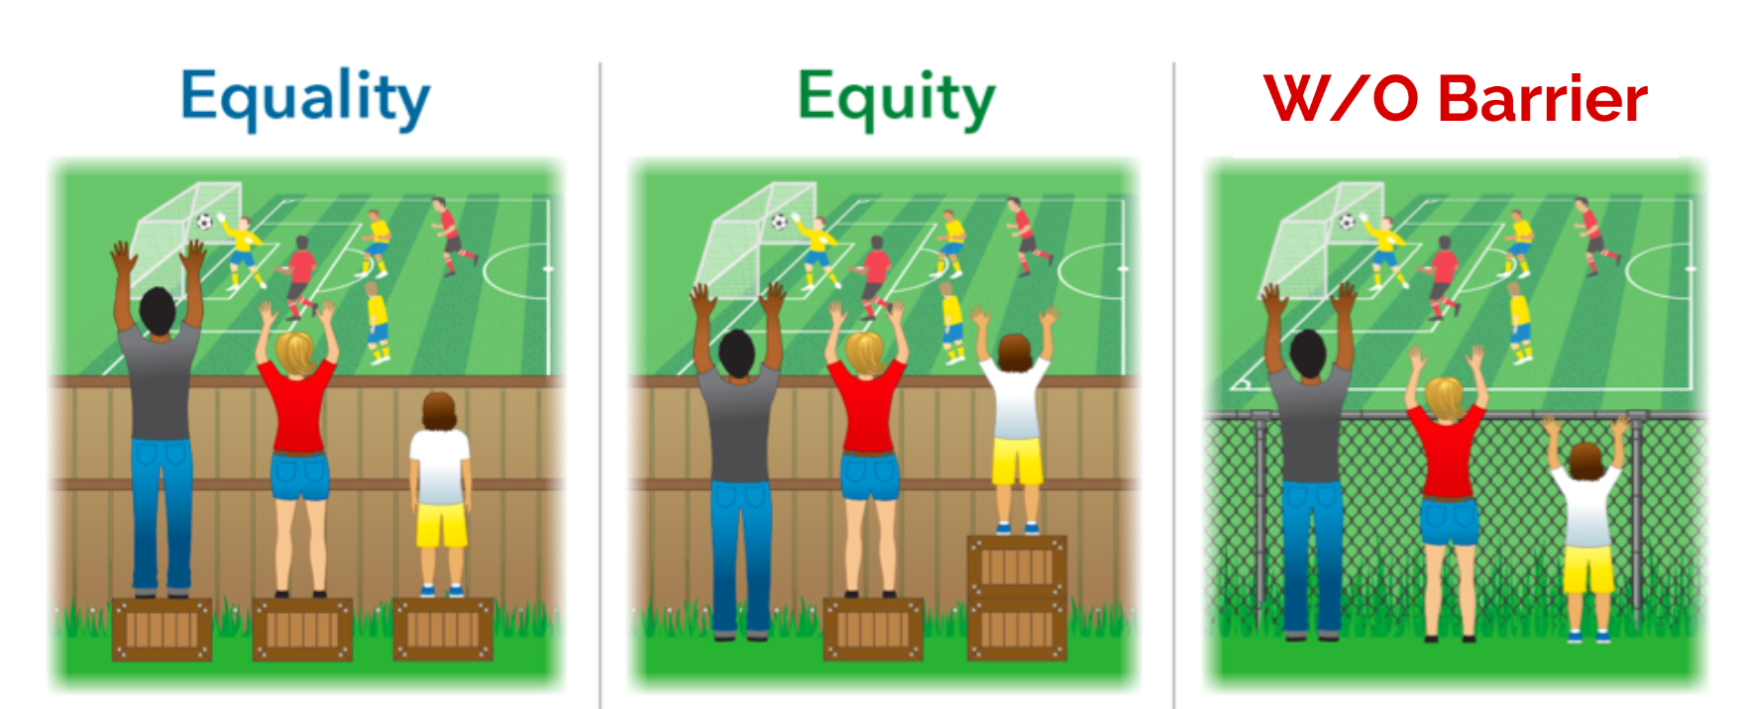
Reduce Barrier

Slide 59
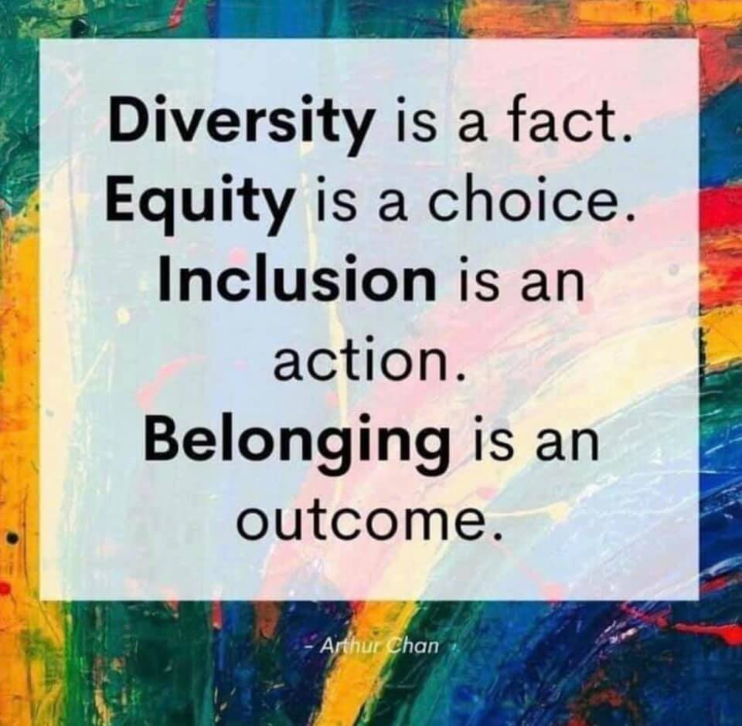
Diversity is a fact.
Equity is a choice.
Inclusion is an action.
Belonging is an outcome.

Slide 60
Thank you for joining us for this discussion.
If you have additional ideas you want to share, please email – ctomblin@sgprc.org
Notes:
Important to note that not straight-line change. Can have lots of variability between each of the years. But gives a general sense of trend.

